Slide 1

FIRST REVIEW DDoS Protection System for Cloud: Architecture and Tool Project Category : RESEARCH
Supervisor Name Dr. Balaji Srikaanth P, AP/NWC Dr. S. Nagendra Prabhu, AP/CINTEL | Batch No. NW000156 Shaurya Singh Srinet – RA2111032010006 Shounak Chandra – RA2111032010026 Charvi Jain – RA2111047010113

Slide 2
Abstract
Increasing cloud adoption heightens the risk of DDoS attacks, threatening service availability and data security.
We propose a scalable DDoS Protection System designed for real-time detection and mitigation in cloud environments.
Utilizes a multi-layered architecture with machine learning to distinguish between malicious and legitimate traffic patterns.
Ensures seamless integration across various cloud platforms while maintaining performance and minimizing false positives.
Aligns with industry security standards to safeguard data integrity and service continuity.

Slide 3
Introduction
Proposed Solution:
Cloud-native DDoS Protection System using machine learning for real-time anomaly detection and automated traffic filtering.
Differentiates between malicious and legitimate traffic to ensure continuous service.
Key Features:
Scalable and adaptable to various cloud architectures.
Compliant with industry standards for data integrity and security.
Impact:
Handles high traffic volumes (many Mbps) while maintaining optimal cloud resource utilization.
Ensures uninterrupted user experience with no service degradation or increased latency.
Adapts over time, improving detection and response by learning emerging attack patterns.

Slide 4
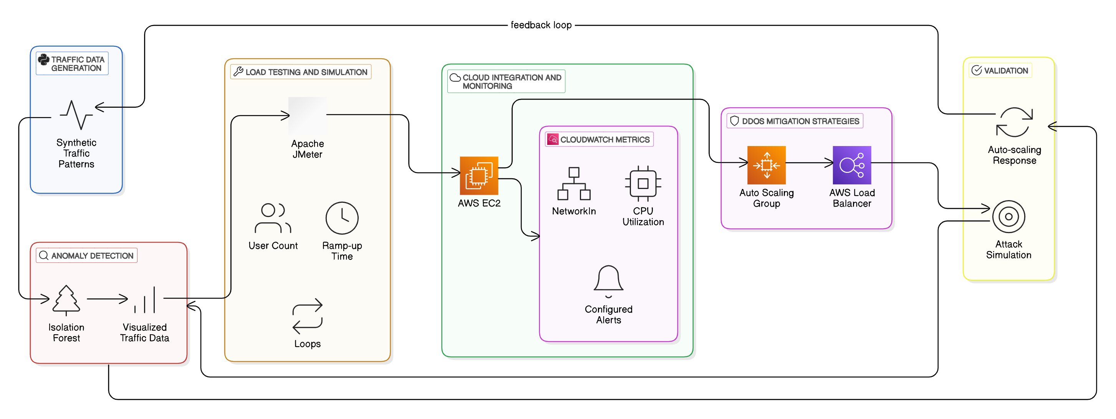
Architecture Diagram

Slide 5
Traffic Simulation & Data Generation
JMeter Setup for Traffic Simulation
Tool Used: JMeter for simulating both normal and DDoS traffic patterns.
Objective: Generate realistic traffic for training the Isolation Forest model.
Current Status:
Traffic simulation setup is complete.
Foundation laid for training machine learning models to detect DDoS attacks.

Slide 6
Anomaly Detection with Machine Learning
Isolation Forest Model for DDoS Detection
Model: Isolation Forest Algorithm is being implemented for anomaly detection.
Functionality:
Detects abnormal traffic patterns indicative of potential DDoS attacks.
Triggers mitigation actions via AWS Auto-Scaling and Load Balancing.
Current Status:
The model is actively being fine-tuned to improve its accuracy in detecting attack patterns in real-time.

Slide 7
Next Steps
Model Optimization & Real-Time Integration
Objective: Further optimize the Isolation Forest model by refining feature selection and hyperparameters.
Real-Time Integration:
Begin integrating the model into a live environment to trigger real-time mitigation based on detected anomalies.
Scaling & Performance Testing
Upcoming Tasks:
Conduct performance testing with a broader range of DDoS attack scenarios (volumetric and application-layer).
Assess how well the system scales under high traffic loads and adjust accordingly.

